Slide 1
Cryotherapy Devices
Christopher Ash
Durable Medical Equipment Coordinator
The Alpine Clinic, PLLC

Slide 2
What is Cryotherapy
A method of icing a localized area using a device to help reduce swelling and inflammation.
Controls Swelling
Pain management
Assist in recovery
May decrease medication use
Devices can be used on either side of body

Slide 3
Insurance
Unfortunately, these devices are not covered by insurance companies.
  Workman’s comp patients please contact Chris @ 603-991-0480
Devices are purchased out of pocket
If you would like a device or want to come look them. Please Call Chris @ 603-991-0480.
  If a device is wanted, please contact Chris at the latest, the Thursday before your scheduled surgery.

Slide 4
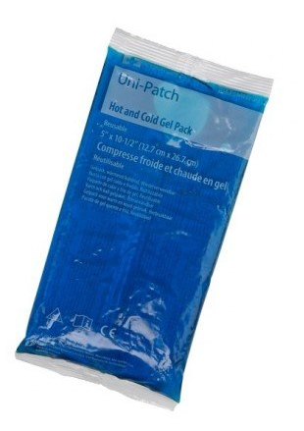
Hot/Cold Gel Pack
1 Hot/Cold Gel Pack: $10.00
Can be used for cold and hot applications
It will retain heat or cold for about 1 hour
Moldable unlike a bag of like ice
20 minutes on 20 minutes off
  Please have a barrier between leg and device

Slide 5
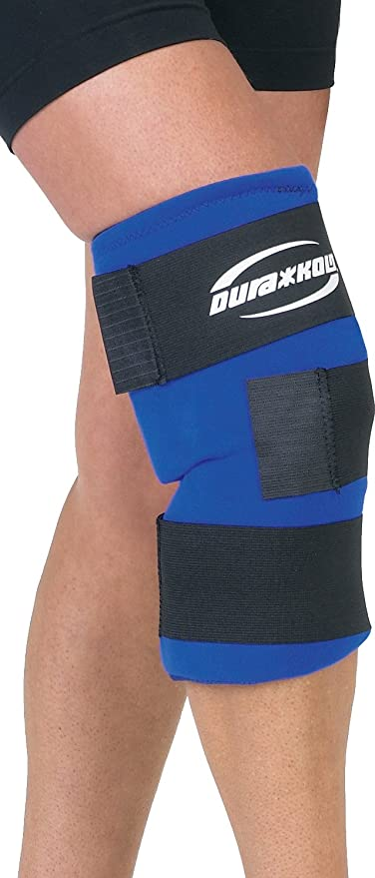
Knee Gel Wrap with 2 Gel packs
Cost: $80.00
Comes with 2 gel packs
  1 gel pack is placed in device while the other one will be in freezer
Elastic bands for straps
Stays cold for about 2 hours
20 minutes on 20 minutes off
  Please have a barrier between leg and device

Slide 6
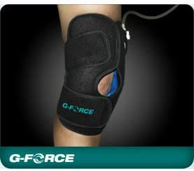
G-Force Cryotherapy Compression Knee Brace
Cost: $80.00
Comes with 2 gel packs
  1 gel pack is placed in device while the other one will be in freezer
Gel pack will last about 2 hours
Air Compression
Straps do not stretch
Stays cold for about 2 hours
20 minutes on 20 minutes off
  Please have a barrier between leg and device

Slide 7
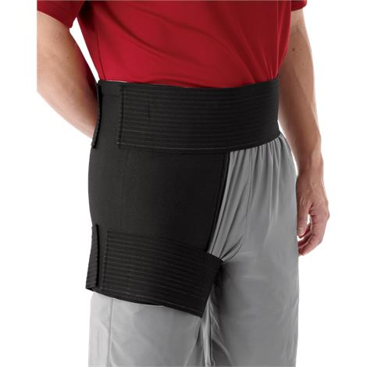
Hip Wrap with 4 Gel Packs
Cost $80.00
The waist/thigh bands are elastic and fits a majority of patients
Stays cold for about 2 hours
Comes with 4 gel packs
  2 gel packs are used at once and the other 2 will go into freezer
20 minutes on 20 minutes off
  Please have a barrier between hip and device

Slide 8
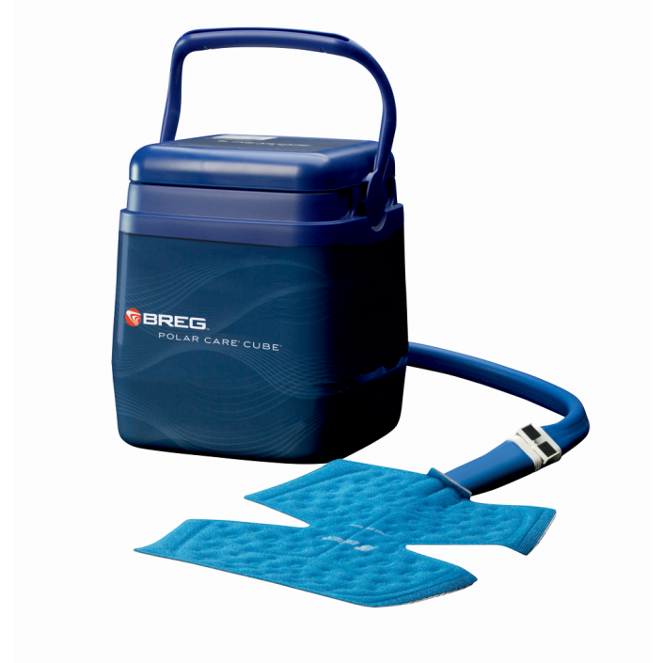
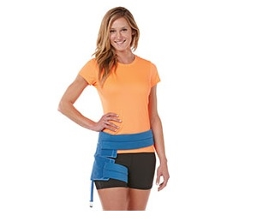
Breg Polar Care Cube (Motorized)
Will come with either hip or knee pad when ordered
Cost: $200.00
Picture 1 (Device with knee pad)
Picture 2 (Hip Wrap)
Motorized not gravity fed
  Ice and water are added to the device and the machine will circulate the cold water to the pad.
Very reliable machine, we have had no issues with this device.
6-8 hours of continuous cold therapy
20 minutes on 20 minutes off
  Please use a barrier between knee or hip pad

